Slide 1


Slide 2
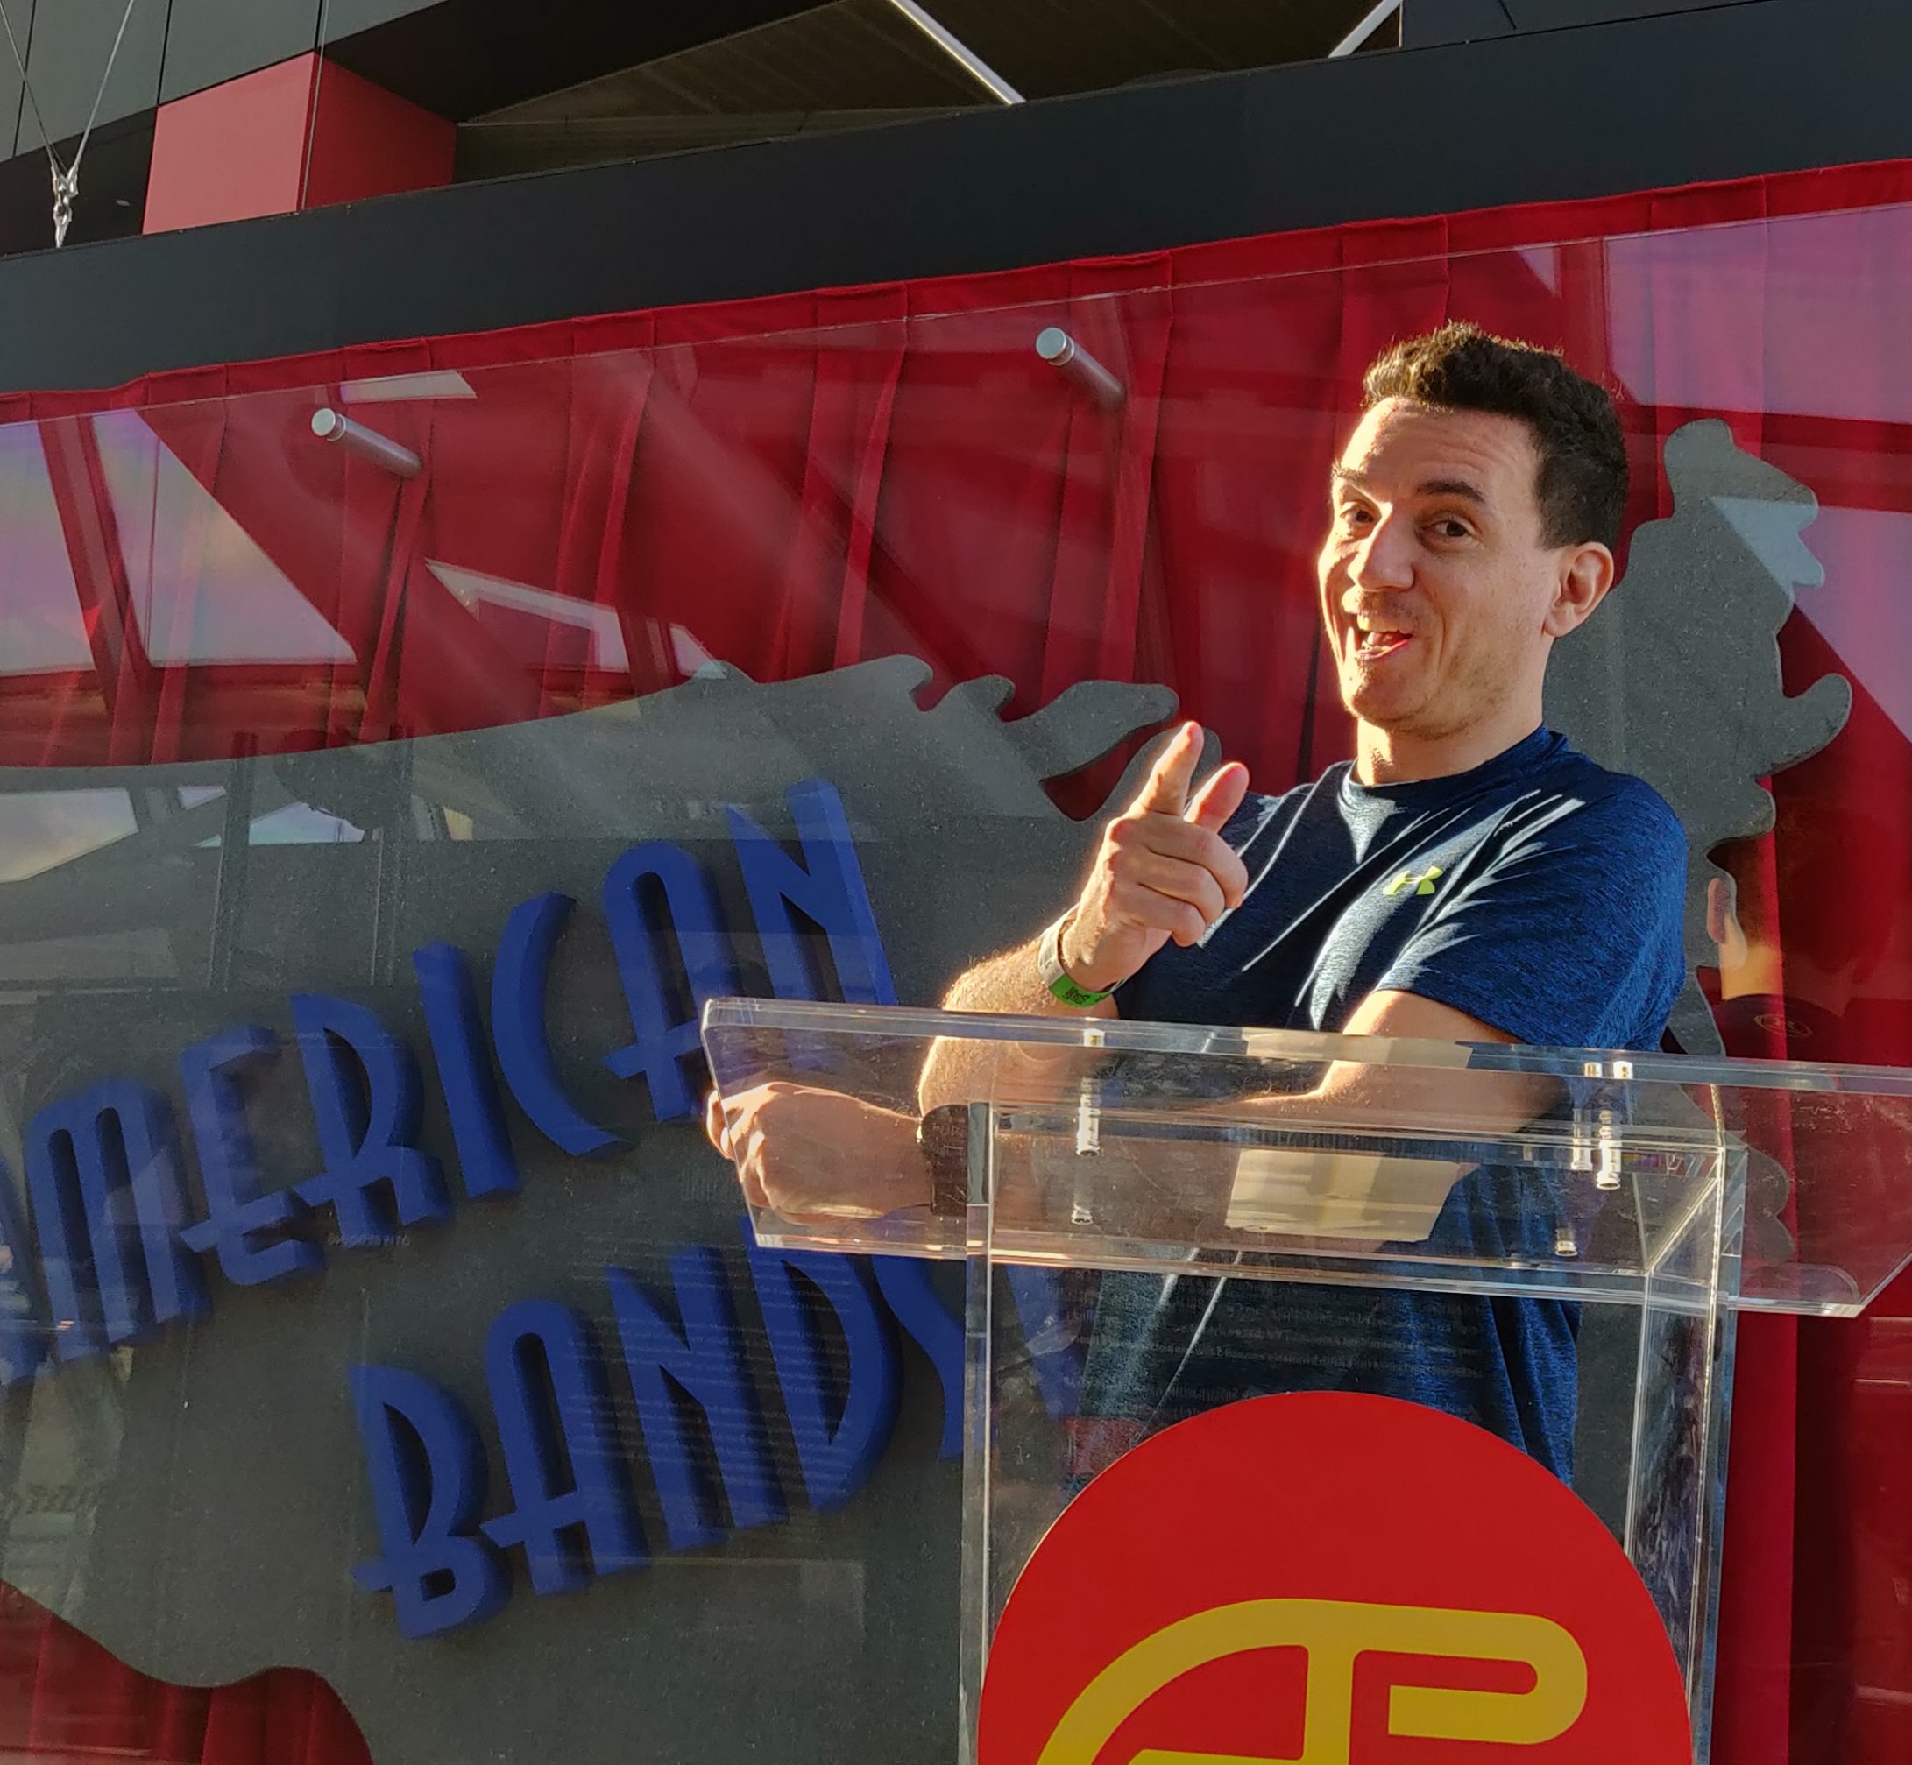
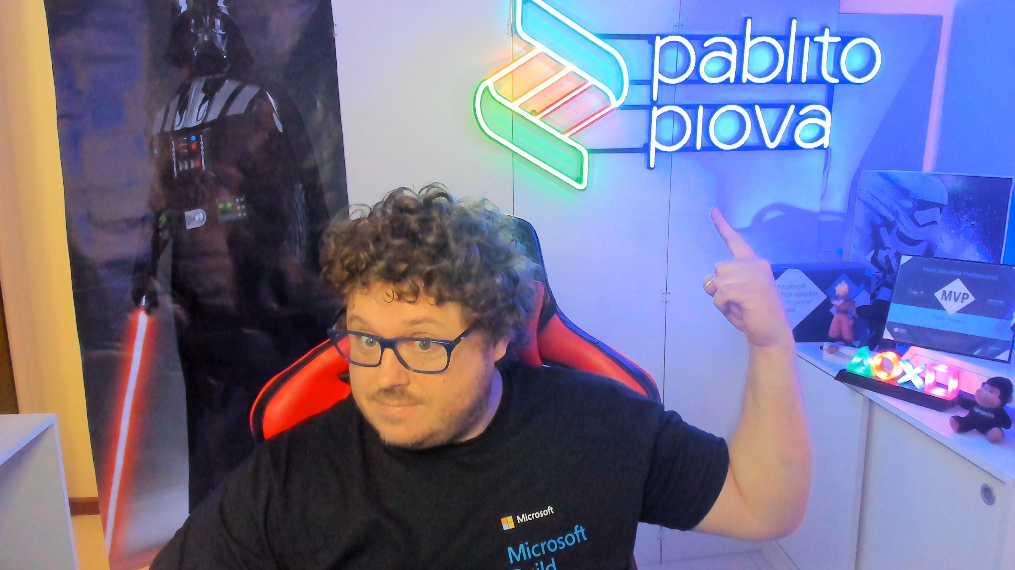
Speakers
Bruno Capuano
Pablo Piovano
Principal Cloud Advocate
@elbruno | aka.ms/elbruno
Microsoft MVP AI @ppiova
Notes:
Nuestros moderadores que apoyaran a contester preguntas en el chat

Slide 3
Hack Together: RAG Hack
aka.ms/RAGhack
Week 1: September 3 - 8
9
MONDAY
3
TUESDAY
4
WEDNESDAY
5
THURSDAY
6
FRIDAY
7
SATURDAY
8
SUNDAY
RAG 101
.NET
Azure AI Studio
Python
Langchain4J
LangchainJS
Responsible AI
MongoDB
Azure AI Search
PostgreSQL
Azure SQL
GraphRAG
Multi-channels
Hack!
Hack!
Hack!
Hack!
Hack!
Hack!
Week 2: September 9 - 14
9
MONDAY
10
TUESDAY
11
WEDNESDAY
12
THURSDAY
13
FRIDAY
14
SATURDAY
15
SUNDAY
Semantic Kernel
Spring AI
Vision models
Internationalization
VSCode Agent
Agentic RAG
Code Interpreter
AI Studio Advanced
AutoGen
Data Access Control
Fine Tuning
Model catalog
Evaluations
Hack!
Hack!
Hack!
Hack!
Hack!
Hack!
Hack!
Hack!
Hack!
Submissions due September 16, 11:59 PM PT!

Slide 4
Retrieval Augmented Generation 101

Slide 5
Agenda
What is RAG?
Simple RAG vs. Advanced RAG
RAG components
RAG solution deep dive

Slide 6
LLMs: Large Language Models

Slide 7
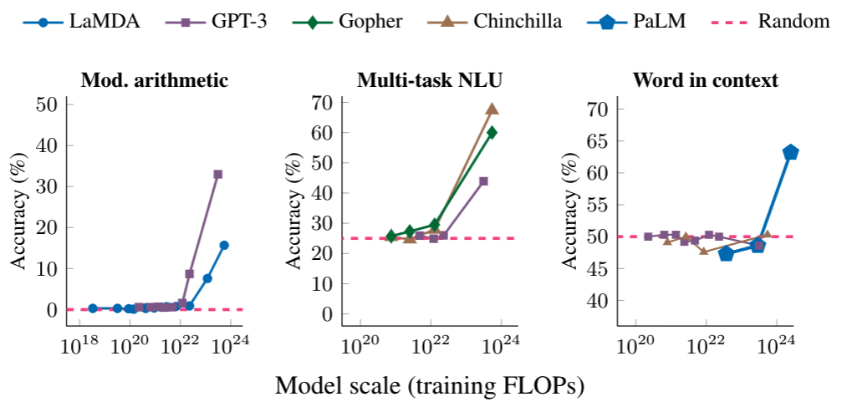
LLM: Large Language Model
An LLM is a model that is so large that it achieves general-purpose language understanding and generation.
Review: This movie sucks.
Sentiment: negative
Review: I love this movie:
Sentiment:
Input
LLM
Output
positive

Slide 8
Popular LLMs
Model | # of Parameters | Creator
GPT 3.5 | 175 B | OpenAI
GPT 4 | Undisclosed | OpenAI
GPT 4o | Undisclosed
Gemini | Undisclosed | Google
Claude 3 | Undisclosed | Anthropic
LlaMA 3 | 8, 70, 405 B | Meta

Slide 9
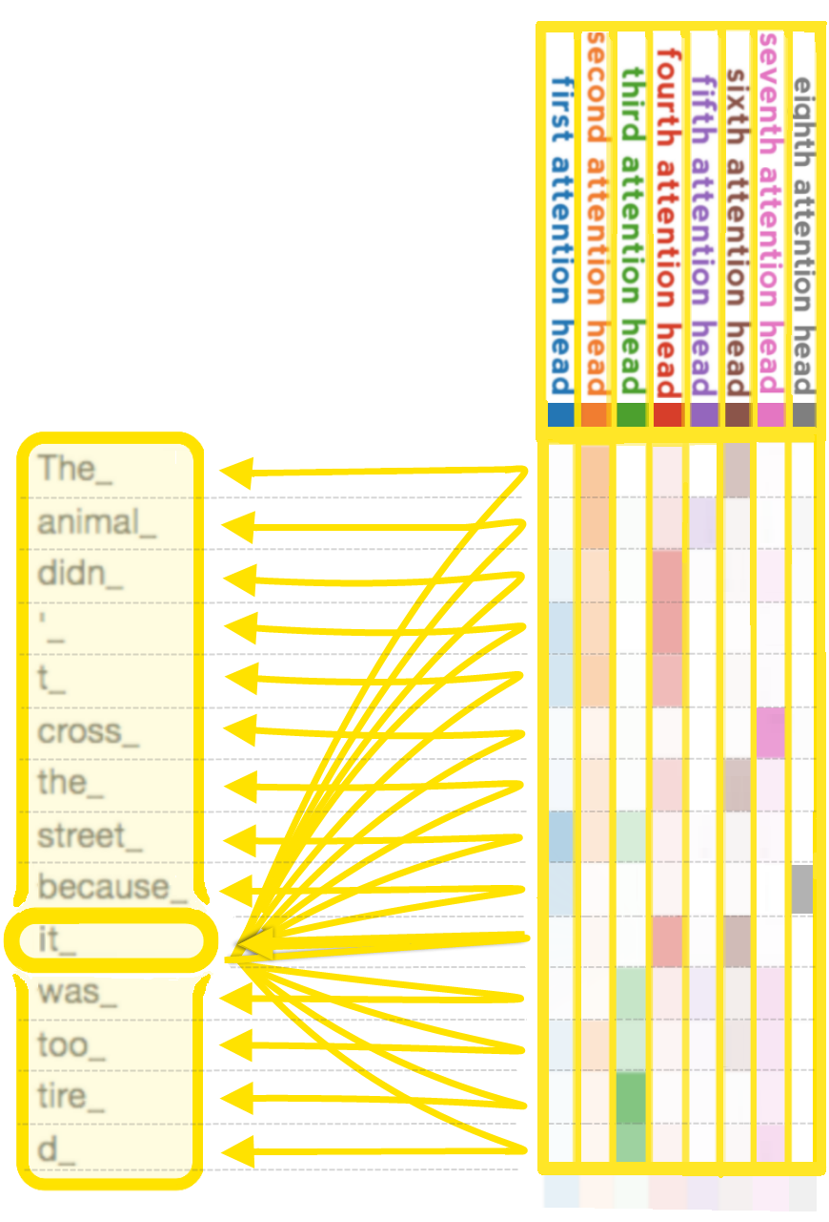
GPT: Generative Pre-trained Transformer
GPT models are LLMs based on Transformer architecture from "Attention is all you need" paper
Learn more:
Andrej Karpathy: 🎥 State of GPT
Andrej Karpathy: 🎥 Let's build GPT: from scratch, in code

Slide 10
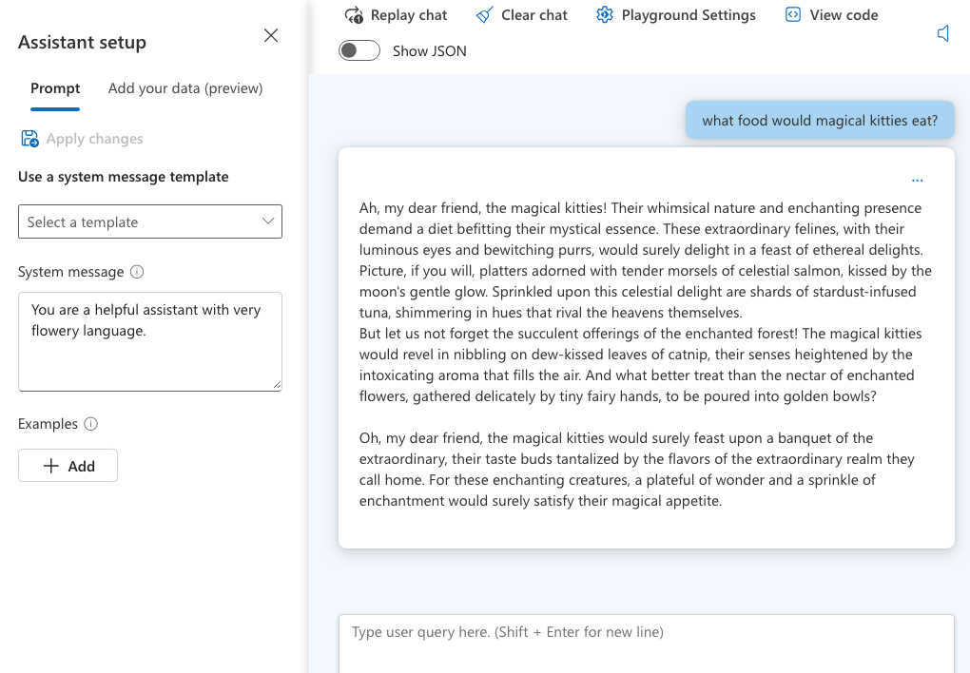
Using OpenAI GPT models: Azure AI Studio
System message
+
User question
=
Chat Completion response

Slide 11
Using OpenAI GPT models: Python
response = openai.chat.completions.create(
stream=True,
messages = [
{
"role": "system",
"content": "You are a helpful assistant with very flowery language"
},
{
"role": "user",
"content": "What food would magical kitties eat?”
}
])
for event in response:
print(event.choices[0].delta.content)

Slide 12
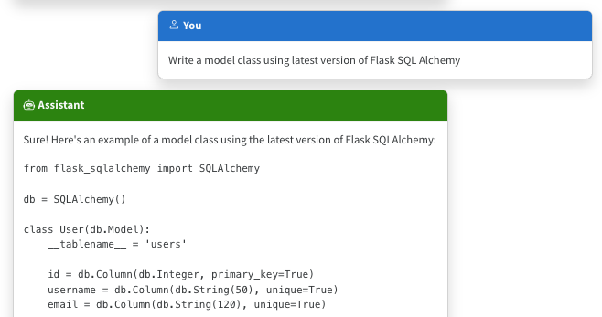
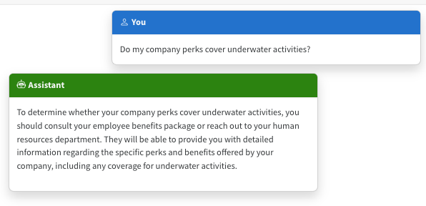
The limitations of LLMs
Outdated public knowledge
No internal knowledge

Slide 13
Integrating domain knowledge
Prompt engineering
Fine tuning
Retrieval Augmented
Generation
In-context learning
Learn new skills
(permanently)
Learn new facts
(temporarily)

Slide 14
Retrieval Augmented Generation

Slide 15




RAG: Retrieval Augmented Generation
Yes, your company perks cover underwater activities such as scuba diving lessons ¹
Do my company perks cover underwater activities?
PerksPlus.pdf#page=2: Some of the lessons covered under PerksPlus include: · Skiing and snowboarding lessons · Scuba diving lessons · Surfing lessons · Horseback riding lessons These lessons provide employees with the opportunity to try new things, challenge themselves, and improve their physical skills.….
User
Question
Document Search
Large Language Model

Slide 16
RAG with OpenAI Python SDK
user_query = "Do benefits cover underwater activities?"
retrieved_content = "PerksPlus.pdf: Some activities covered include scuba diving, snorkeling, surfing lessons, horseback riding, skiing, etc.....\n Benefits.pdf: All companies receive the PerksPlus benefit...\n"
response = openai.chat.completions.create(
messages = [
{
"role": "system",
"content": "You must answer questions according to sources, and cite all sources. Cite sources inside square brackets."
},
{
"role": "user",
"content": user_query + "\n Sources: \n" + retrieved_content
}
])

Slide 17
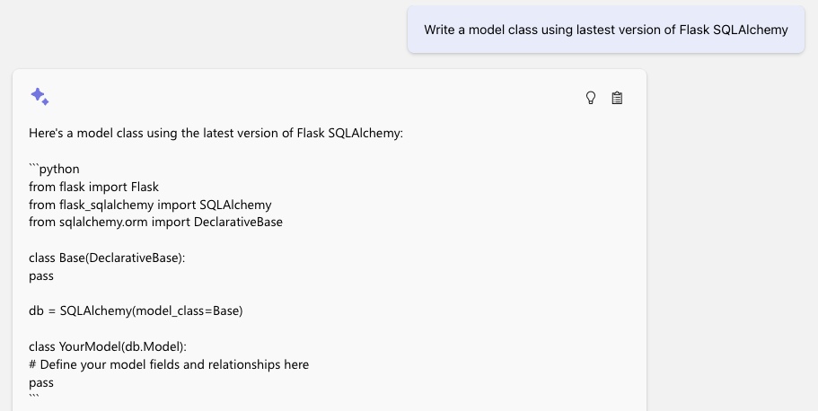
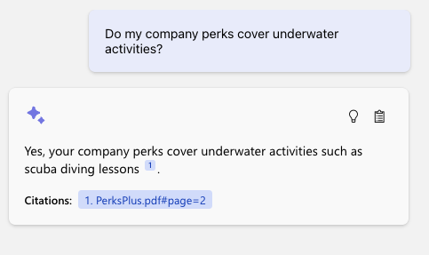
The benefits of RAG
Up-to-date public knowledge
Access to internal knowledge

Slide 18
Types of RAG

Slide 19
Types of RAG
RAG flows:
Simple RAG
Advanced RAG with Query rewriting
RAG sources:
Structured data (DB tables)
Documents (PDF, MD, etc.)
GraphRAG

Slide 20
Simple RAG
For great hiking shoes, consider the TrekExtreme Hiking Shoes ¹ or the Trailblaze Steel-Blue Hiking Shoes ²
What's the best shoe
for hiking?
[101]:
Name: TrekExtreme Hiking Shoes Price: 135.99
Brand: Raptor Elite
Type: Footwear
Description: The Trek Extreme hiking shoes by Raptor Elite are built to ensure any trail.
…
User
Question
Search
Large Language Model

Slide 21
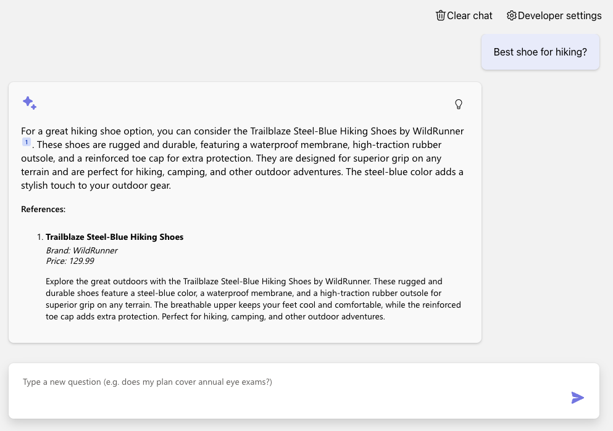
Simple RAG (on PostgreSQL)
Azure OpenAI +
Azure PostgreSQL Flexible Server +
Azure Container Apps
Code:
aka.ms/rag-postgres
Demo:
aka.ms/rag-postgres/demo

Slide 22
Advanced RAG with query re-writing
For great hiking shoes, consider the TrekExtreme Hiking Shoes ¹ or the Trailblaze Steel-Blue Hiking Shoes ²
what's a good shoe for a mountain trale?
mountain trail shoe
[101]:
Name: TrekExtreme Hiking Shoes Price: 135.99
Brand: Raptor Elite
Type: Footwear
Description: The Trek Extreme hiking shoes by Raptor Elite are built to ensure any trail.
…
User
Question
Large Language Model
Search
Large Language Model

Slide 23
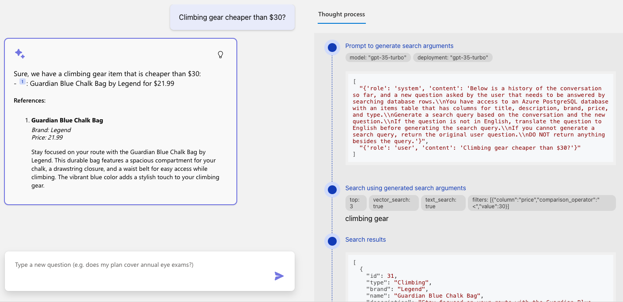
Advanced RAG (on PostgreSQL)

Slide 24
Query rewriting with function calling
Do you sell climbing gear cheaper than $30?
search_database(
"climbing_gear",
{"column": "price",
"operator" : "<",
"value" : "30"
}
)
Large Language Model with function calling
User
Question
Notes:
TODO: live-demo a brand filter

Slide 25
Advanced RAG with query rewriting via function calling
We offer 2 climbing bags for your budget:
SummitStone Chalk Bag ¹
Guardian Blue Chalk Bag ²
Do you sell climbing gear cheaper than $30?
“Do you sell…”
price < 30
“Do you sell…”
“climbing gear”
[12]:
Name: SummitStone Chalk Bag Price:29.99
Brand:Grolltex
Type:Climbing
Description: The SummitStone Chalk Bag in forest green is a must-have for climbers seeking adventure.
…
User
Question
LLM
with function calling
Search
LLM

Slide 26
RAG on documents
Yes, your company perks cover underwater activities such as scuba diving lessons ¹
Do my company perks cover underwater activities?
PerksPlus.pdf#page=2: Some of the lessons covered under PerksPlus include: · Skiing and snowboarding lessons · Scuba diving lessons · Surfing lessons · Horseback riding lessons These lessons provide employees with the opportunity to try new things, challenge themselves, and improve their physical skills.….
User
Question
Search
Large Language Model

Slide 27
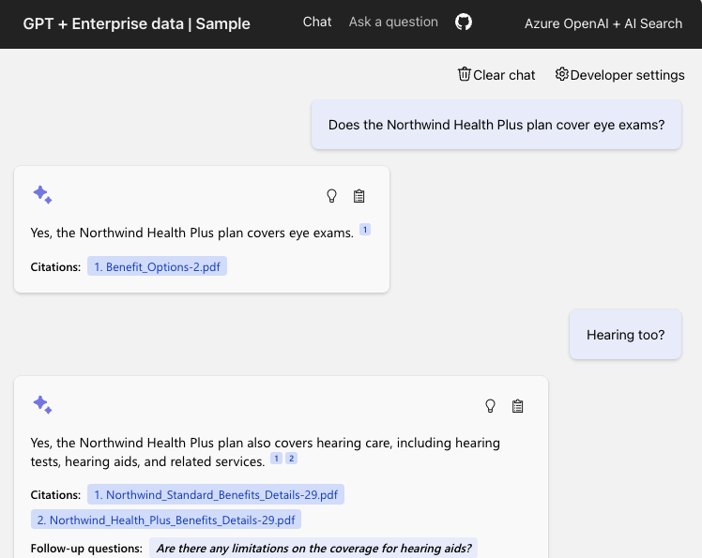
RAG on documents
Azure OpenAI +
Azure AI Search +
Azure App Service
Supports simple and advanced flows
(Ask tab vs. Chat tab)
Code:
aka.ms/ragchat
Demo:
aka.ms/ragchat/demo

Slide 28


RAG data sources
Database rows
(Structured data)
Documents
(Unstructured data)
PDFs, docx, pptx, md, html, images
You need a way to vectorize & search target columns.
PostgreSQL + pgvector
Azure SQL + vector search (upcoming)
Cosmos MongoDB + vector
You need an ingestion process
for extracting, splitting, vectorizing,
and storing document chunks.
Azure AI Search +
Integrated Vectorization
Document Intelligence or

Slide 29
RAGHack: Next steps
aka.ms/raghack
Register for the hackathon @ aka.ms/raghack/register
Hack, hack, hack! Try our code samples or start from scratch!🧑🏿‍💻 👩🏻‍💻 👩🏼‍💻
For any questions, post in GitHub forum or attend Discord Office Hours. 🙋🏼 🙋🏾‍♀️
Join more live RAG sessions! aka.ms/raghack/streams
Submit your project before September 16th 11:59 PM PT to win prizes! 💵

